Slide 1



HUAWEI-NUS
Innovation Challenge
Solution presentation:
Attention-based LSTM Classification Algorithm
BE2601 Management Principles, Skills and Competencies
Pivoting, Strategizing, Executing
General Electric Renewables
Team: Alchemy Squad
Team Members: Kong Heyi
Lyu Lanqing
Nie Xiaoyu
Qi Fulin
Yin Li
Zhang Zishuo
2023/04/27

Slide 2






Group Members
Kong Heyi,
Computer Science
Lyu Lanqing, Quantitative Finance
Nie Xiaoyu, Physics
Yin Li,
Industrial Systems Engineering
Zhang Zishuo, Business Analytics
Qi Fulin, Mathematics

Slide 3
Content Overview
1
Introduction
2
Model Development and Implementation
Data cleaning
i. Input normalization formula
ii. Label selection
b. Schematic of neural network in our model
c. Trading procedure
3
Results and Performance Evaluation
Training loss and epoch selection
Trading results
Alternative trading strategy
Exploration of methods and potential improvement
4
Cloud Services and Functions
Model training and data processing with Huawei Cloud services

Slide 4

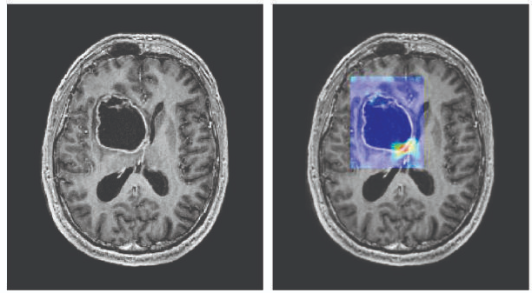
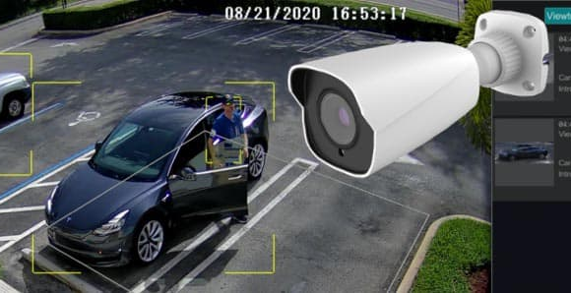

Introduction
Airport face scan
Cancer detection
AI security camera
3D face reconstruction
Notes:
four pics of examples

Slide 5
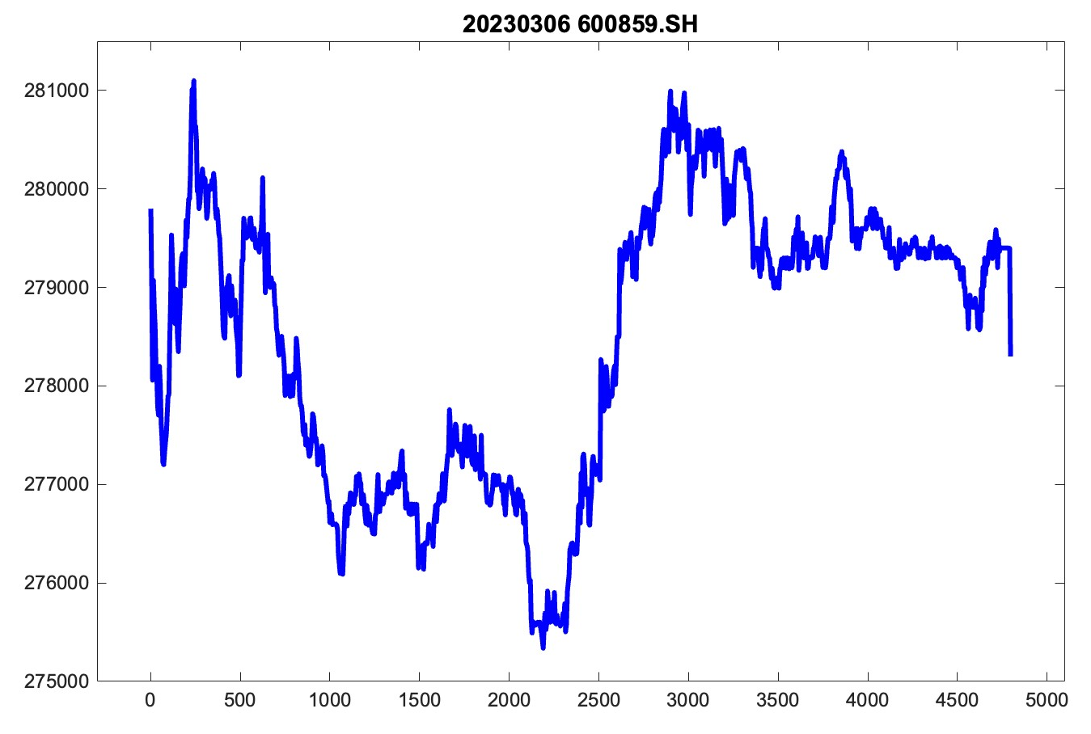

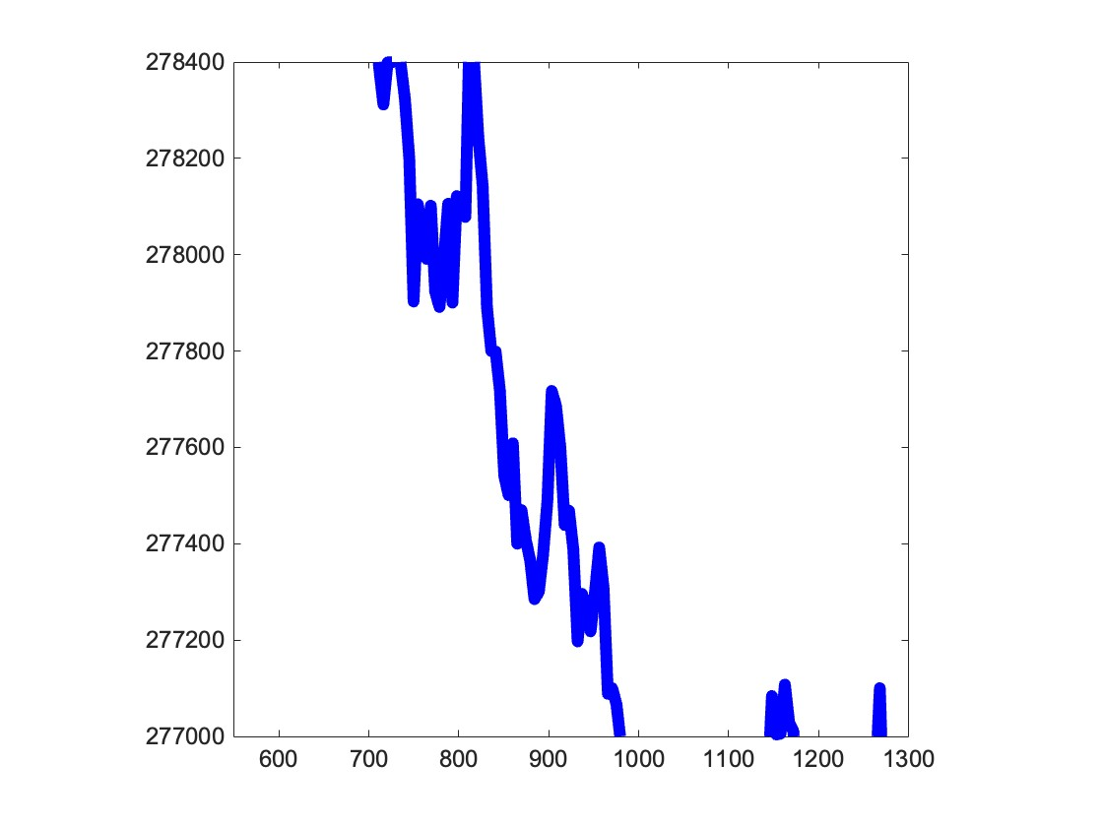
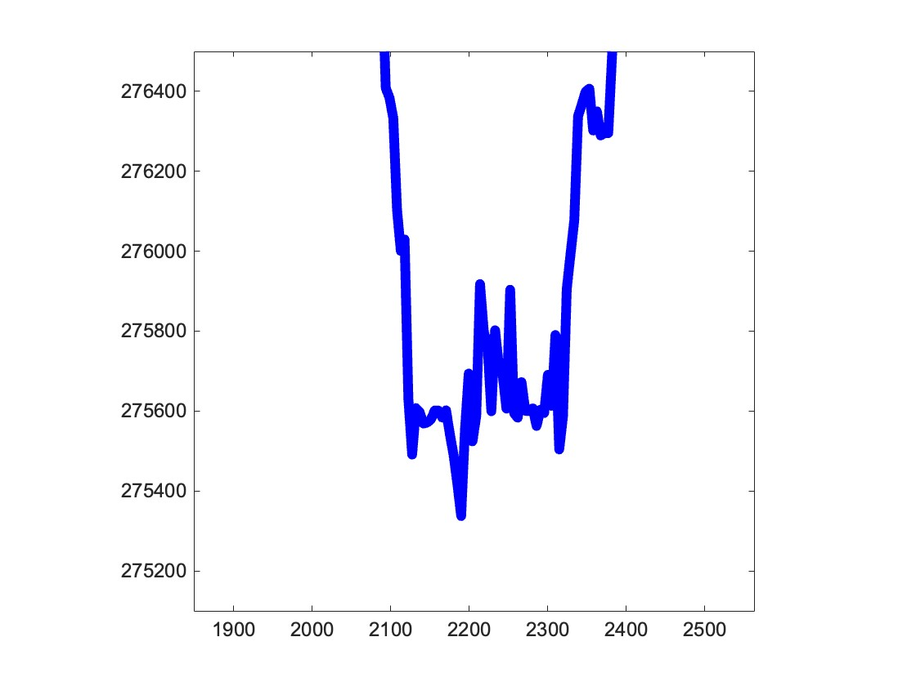


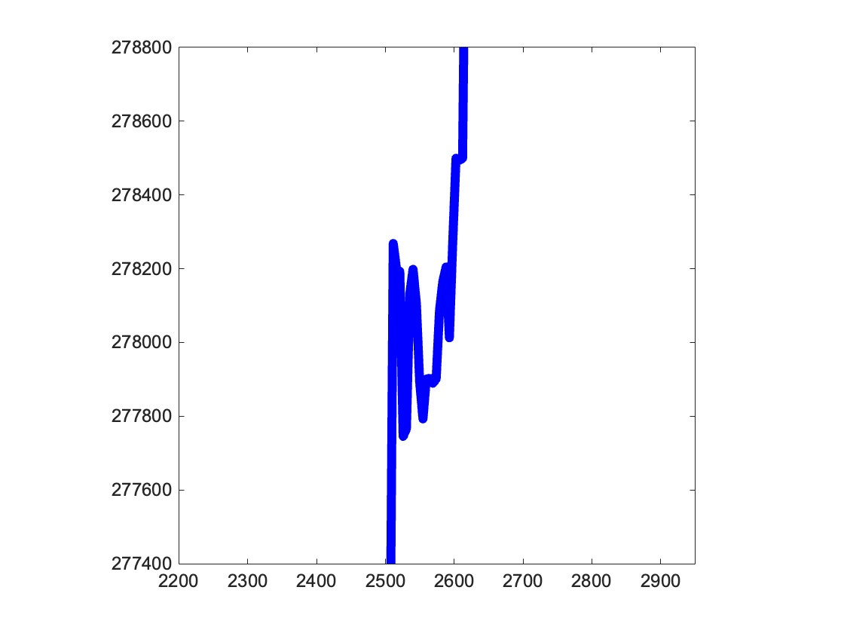
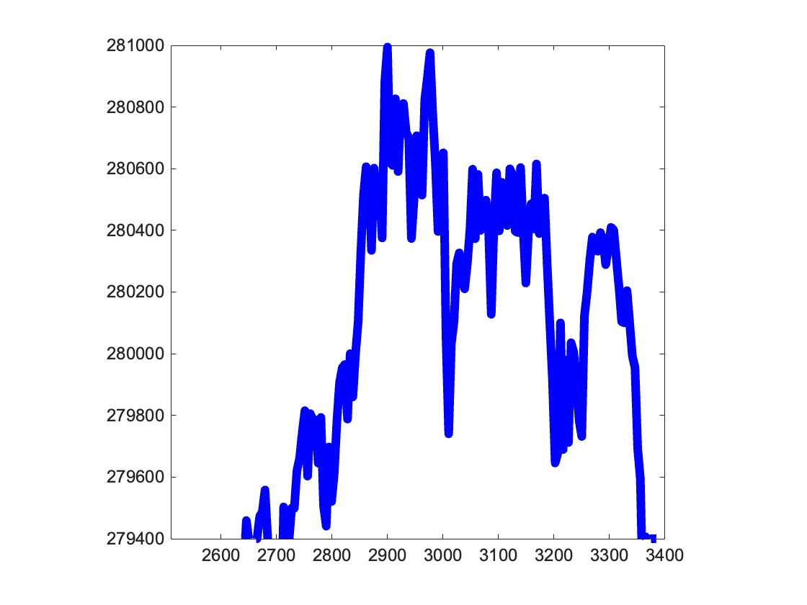
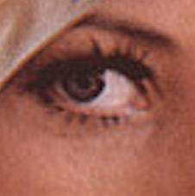
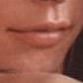
Introduction
d
b
a
a. downward trend
b. U shape
c
a. lamp
b. hat
c
a
d
b
c. upward trend
d. inverted U shape
c. eye
d. mouth
Notes:
lena matlab + stock 4 zoom-in parts Select a part of “Result and Evaluation” graph, a representative stock, add a black dotted box, a = price reduces, b = low peak, c = price increase, d = high peak. 20230306 Put them at side.

Slide 6


2. Model Development and Implementation
a. Training Data Cleaning - i) Input normalization formula
Assumptions
Key Ideas
All stocks have identical or similar behaviours, so stocks with similar trends are expected to have similar performance in the future
Analyse the curvature of stocks and predict the relationship between VWAP and the current price.
Stock performance depends solely on its past performance, so we do not consider external factors, such as policies and market changes
Normalise prices of different stocks, to have a standard weight for training, and common stage for comparison.

Slide 7
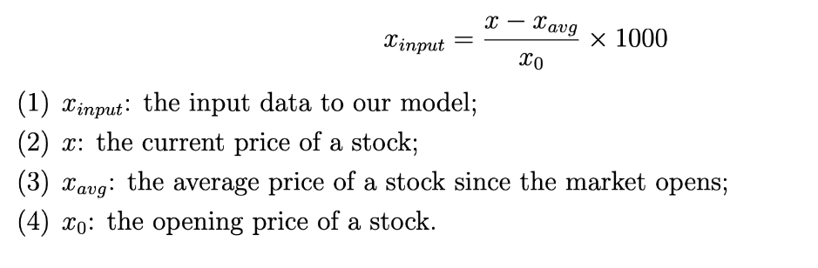
2. Model Development and Implementation
a. Training Data Cleaning - i) Input normalization formula
Reason
We found that the opening price of a stock is likely to be independent of all other factors, so it is unbiased based on our assumptions

Slide 8
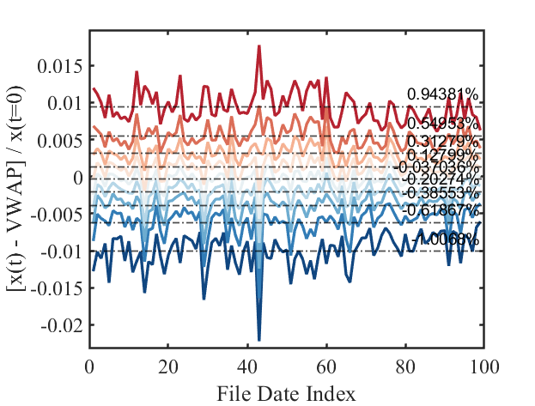
2. Model Development and Implementation
a. Training Data Cleaning - ii) Label selection
Key Idea
Price Difference Distribution
To train the classification neural network, we define N (N=20) classes by looking at the distribution of the price difference between the current price (data[-1]) and Volume-Weighted Average Price (VWAP) of the day as shown in the figure.
Label Definition (Example with 10 classes)
0: (1 - 10.0%) * VWAP <= data[-1] < (1 - 1.01%) * VWAP
1: (1 - 1.01%) * VWAP <= data[-1] < (1 - 0.62%) * VWAP
2: (1 - 0.62%) * VWAP <= data[-1] < (1 - 0.39%) * VWAP
3: (1 - 0.39%) * VWAP <= data[-1] < (1 - 0.20%) * VWAP
4: (1 - 0.20%) * VWAP <= data[-1] < (1 - 0.00%) * VWAP
5: (1 - 0.00%) * VWAP <= data[-1] < (1 + 0.13%) * VWAP
6: (1 + 0.13%) * VWAP <= data[-1] < (1 + 0.31%) * VWAP
7: (1 + 0.31%) * VWAP <= data[-1] < (1 + 0.55%) * VWAP
8: (1 + 0.55%) * VWAP <= data[-1] < (1 + 0.94%) * VWAP
9: (1 + 0.94%) * VWAP <= data[-1] < (1 + 10.0%) * VWAP
Notes:
language confusing? Label definition:

Slide 9
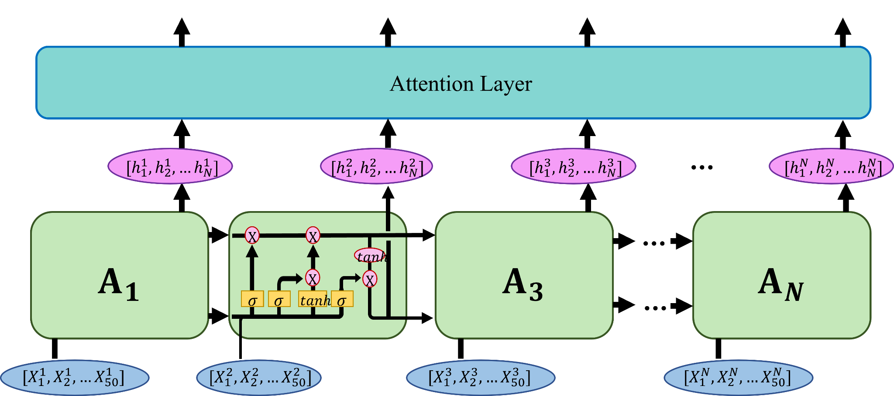
2. Model Development and Implementation
b. Schematic of Neural Network
LSTM Network Architecture for Stock Market Prediction
Key Idea
It's essential to use a sequential neural network that can handle time-dependent data.
We tried RNN, GRU, LSTM, and BLSTM, and found LSTM network performed best.
Parameter used:
Batch = 64,
Sequence = 10.
Input size = 50,
Learning rate = 0.001
Notes:
Now into the section of model development and implementation. We basically decide to use neural network for stock decisions. Given that stock market data are sequential time ticks, …
Evaluate the different performance of the model of each
– Every time the network takes 64 batches of data
– Every batch contains 500 tick data, which is cut in 10 pieces containing 50 data points each. The 10 pieces are input into the LSTM sequentially. We find this achieves better accuracy as well as computational efficiency.
– Learning rate 0.001

Slide 10
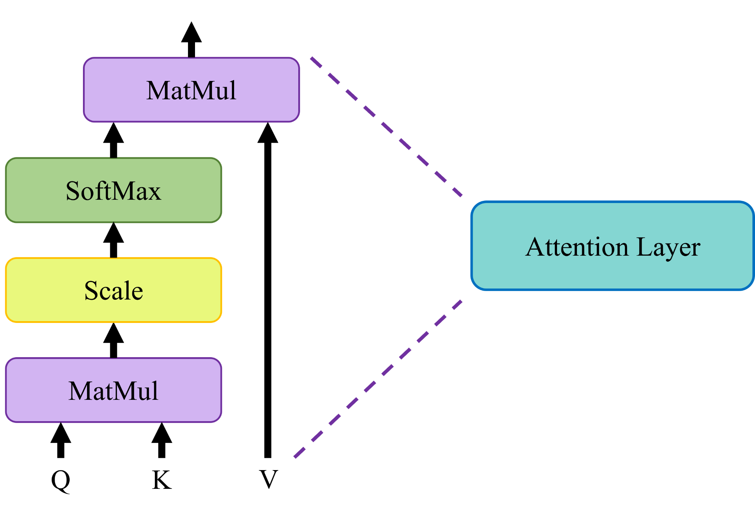
2. Model Development and Implementation
b. Schematic of Neural Network
LSTM Network Architecture for Stock Market Prediction
Key Idea
Attention layer allows the model to focus on certain parts of the input sequence more than others. This is commonly used to increasing the complexity and neurons of the network.
We implemented a “self-attention” layer. Its main advantage is the ability to capture long-range dependencies in input sequence, with relatively low computational cost. This is very applicable to stock trading – prices at different time ticks could be interrelated.
Notes:
This is the internal structure of our attention layer, which is manually built by ourselves. This attention mechanism is also used in the training of chatGPT. Hence, you can also call our model “trading-GPT”
This network does not change the data shape of the input and output

Slide 11
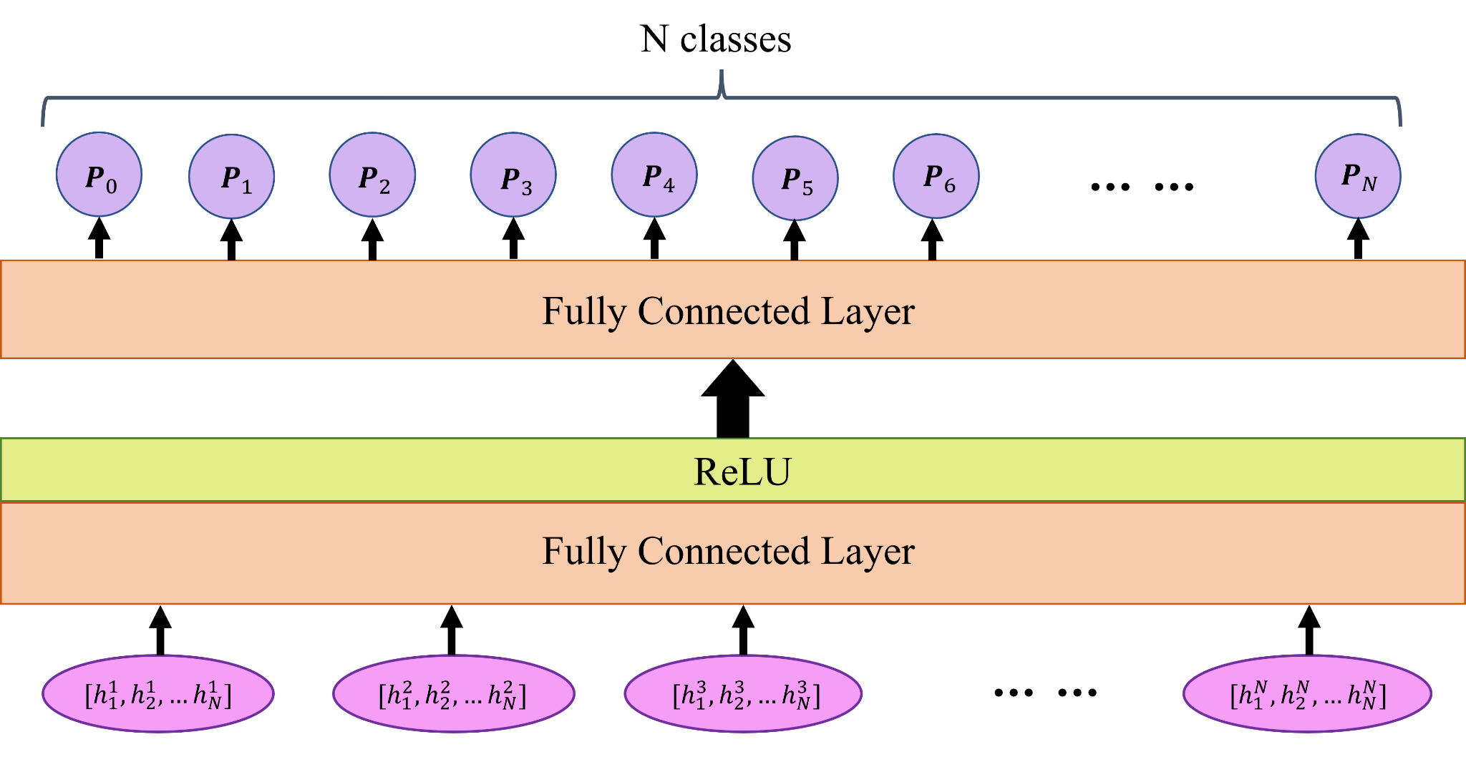
2. Model Development and Implementation
b. Schematic of Neural Network
LSTM Network Architecture for Stock Market Prediction
Key Idea
After the attention layer, a fully connected layer is used to increase the number of neurons and parameters in the network.
The fully connected layer is followed by a ReLU activation layer, which introduces non-linear processing into the network.
Finally, the output of the network is produced by the last fully connected layer with an output dimension of N, which serves as the classification layer for the final network output.
Notes:
We find that a more complex network with more neurons gives better performance.
It gives a N-dimension prediction as the output, and we take the class with the largest possibility as its label.

Slide 12
2. Model Development and Implementation
c. Trading Procedure
Pseudo Code
Explanation
If 9:25:00 < time < 14:00:00:
if prediction < (N/2-1) & cumulated_buy_volume < 100 & current_t – last_buy_t > 75:
buy_volume = N/2 – prediction
if 100 - cumulated_buy_volume < buy_volume:
buy_volume = 100 - cumulated_buy_volume
if prediction > N/2 & cumulated_sell_volume < 100 & current_t – last_sell_t > 75 :
sell_volume = prediction – (N/2-1)
if 100 - cumulated_sell_volume < sell_volume:
sell_volume = 100 - cumulated_sell_volume
Else % time > 14:00:00:
if cumulated_buy_volume < 100 & current_time – last_buy_time > 60:
if buy_times < 3:
buy_volume = (100 - cumulated_buy_volume) / (3-buy_time)
else:
buy_volume = (100 - cumulated_buy_volume)
if cumulated_sell_volume < 100 & current_time – last_sell_time > 60:
if sell_times < 3:
sell_volume = (100 - cumulated_sell_volume) / (3-sell_time)
else:
sell_volume = (100 - cumulated_sell_volume)
In the test (trading) process, we do not give decision until the 500th data in each stock. Starting from the 500th, data[i, i+500] are sent into the pre-trained LSTM.
Prediction of the class 0-9 depends on the maximum probability of outputs.
If predictions < N/2-1, buy_vol = N/2 - predictions; else if predictions > N/2, sell_vol = predictions - (N/2-1); else, no action.
One hour before the end of day, the program will force to complete the leftover shares, and trading times.
Notes:
In the trading procedure, we split N classes in three situations, selling and buying. If the neural network outputs small class, then we decide to buy. If the neural network gives big class number, then we decide to sell. Otherwise, for the medium classes, we do nothing. The volume of buying and selling depend on how small or how big is the class, as is shown in the code marked by blue color.

Slide 13
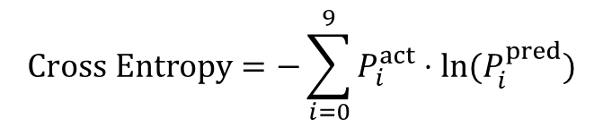
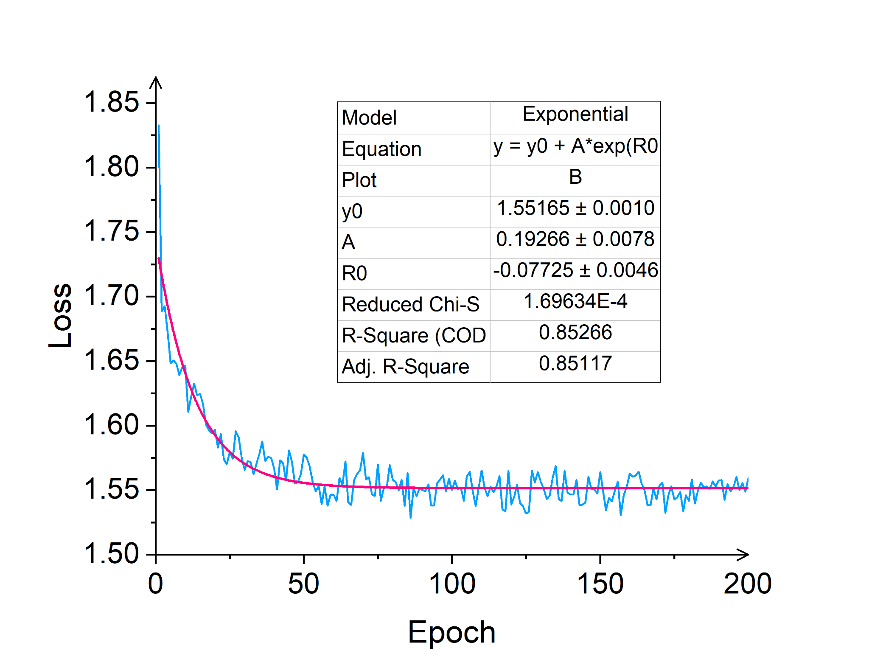
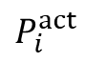
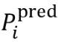
3. Result and Evaluation
a. Training Loss and Epoch Selection
Cross Entropy Loss Function Graph
Cross Entropy Loss Function
(1) is the actual probability of the label i. It should be either 1 or 0.
(2) is the predicted probability of the label i.
Analysis and Epoch Selection
From the curve fitting in loss function graph, we can see that loss is approaching a constant value and minimised from 100 epochs onwards.
Thus, we chose 200 epochs to be safe. The label prediction accuracy with test dataset is 73%.

Slide 14
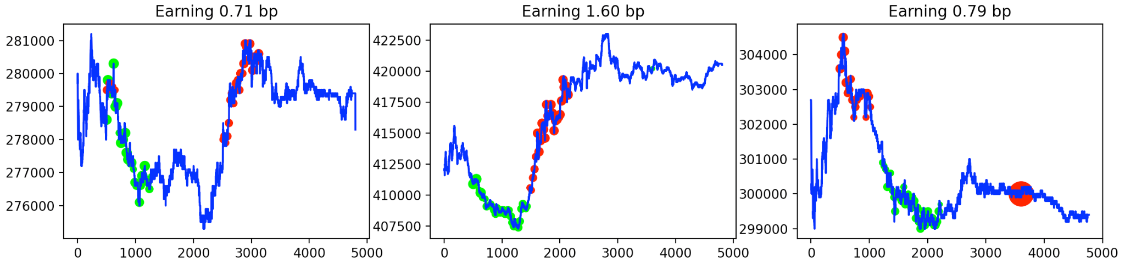
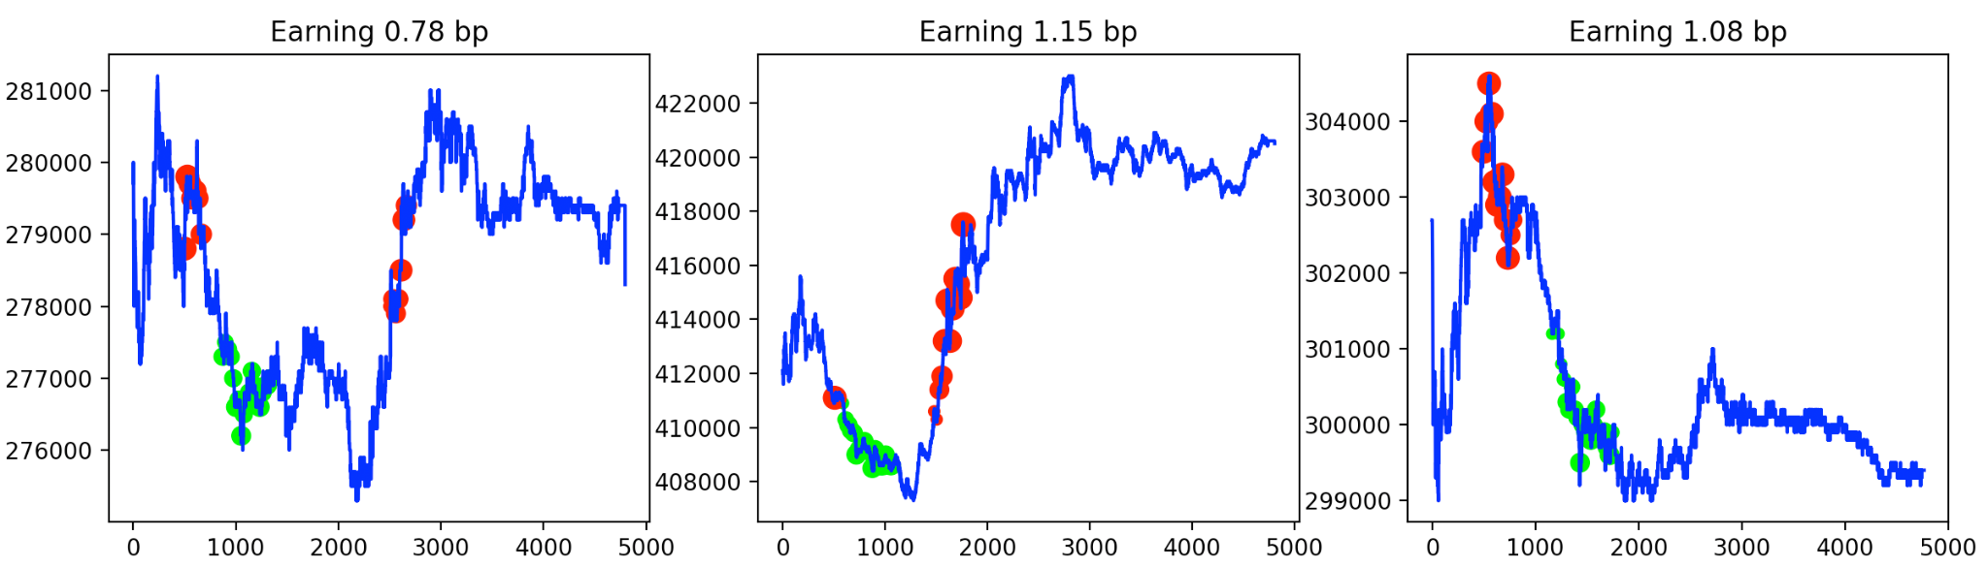
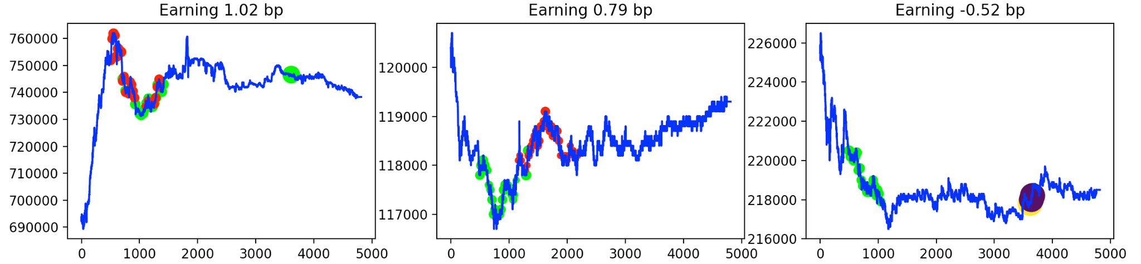
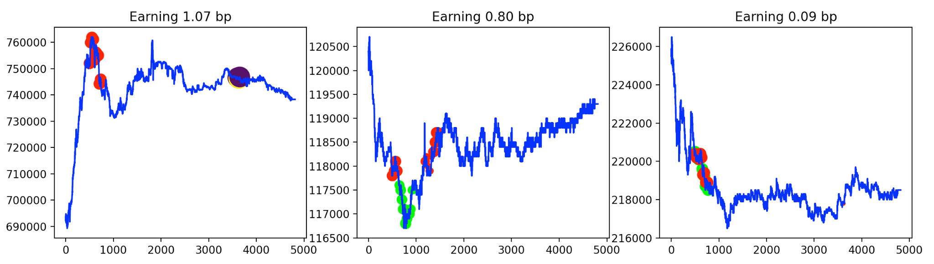
3. Result and Evaluation
b. Trading Results
Legends:
: A Single Stock
: Selling Point
: Buying Point
Dot Size : Trading Volume
Analysis
Good performance across stocks with varying trends.
“Buy Low, Sell High”

Slide 15
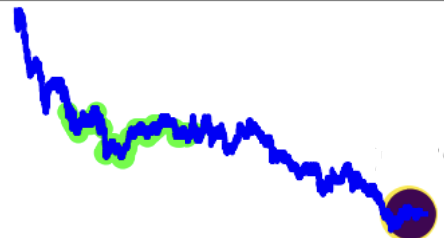
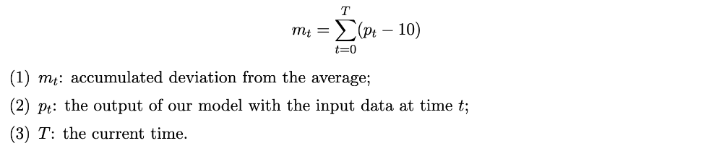
3. Result and Evaluation
c. An Alternative Trading Strategy
Observations
Example
Consideration
If a stock keeps increasing / decreasing, our current trading model tends to only sell/buy this stock with little transaction volume.
If the price of a stock keeps decreasing, we sell some stocks even though the price is not at high points,
vice versa.
We are forced to delay the trading decisions until last minute to complete the required transaction, which might lead to great loss.
“keep decreasing” - cut loss
“keep increasing” - buy and hold
Green points: selling points
Black point: both selling and buying
Implementation:
m_t > 1000 - “keep increasing”
m_t < -1000 - “keep decreasing”
Our formula
Notes:
Note: Original results saved by the side, might need to replace some figure (only keep 3, row 1: original decisions for the 3 stocks , row2: new decisions for the 3 stocks) if we want to show comparison/improvement. Good figures can be 1st(shape is representative and performance has improved), 3rd (show less delayed decisions & improved performance) and last(show less delayed decisions, better performance for overall downward trend).

Slide 16
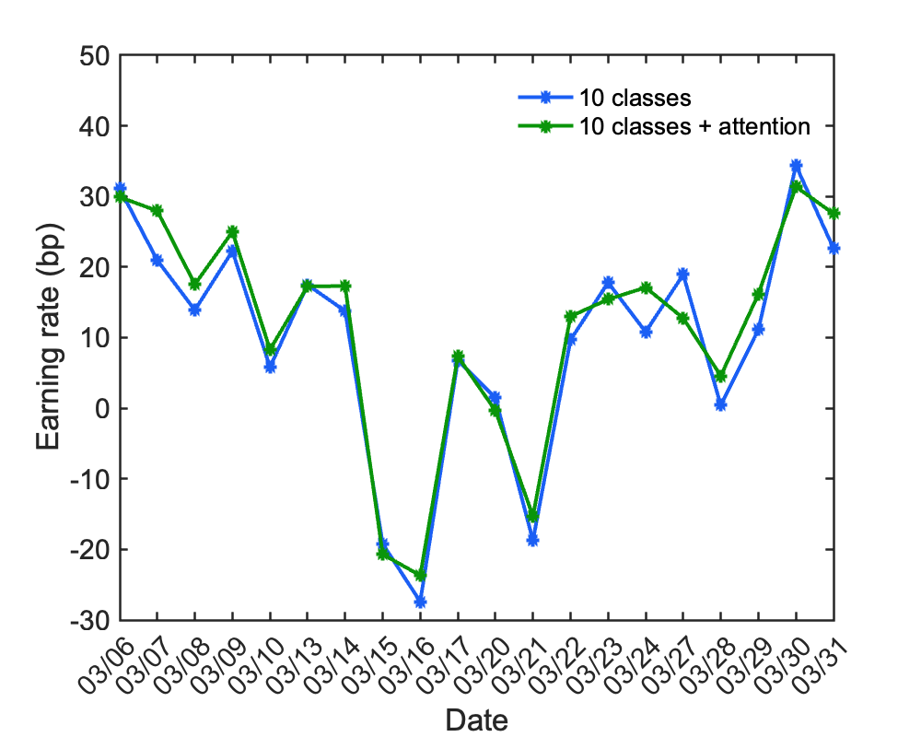
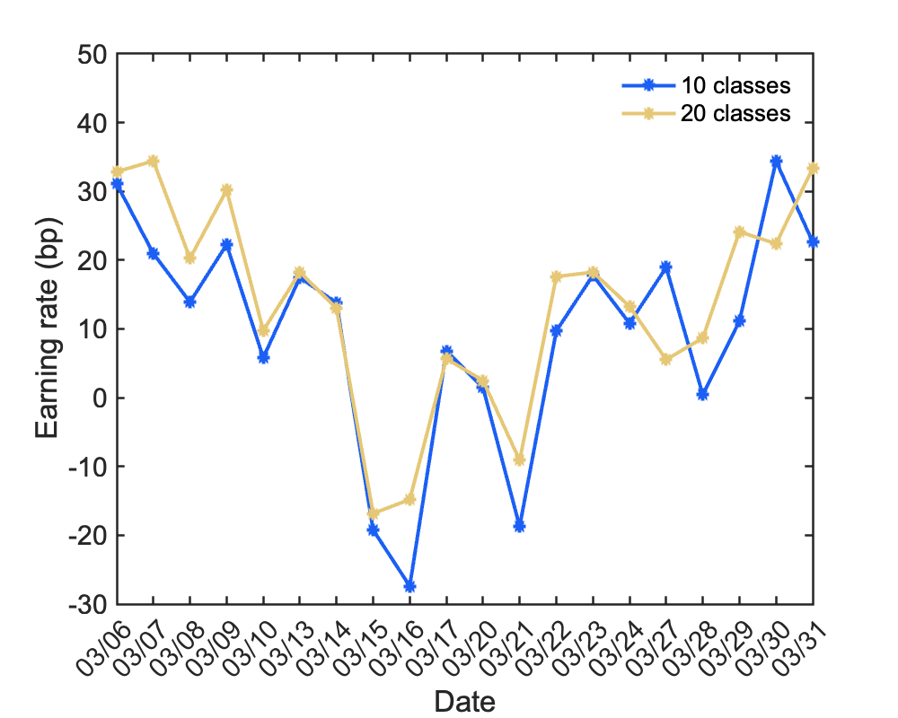
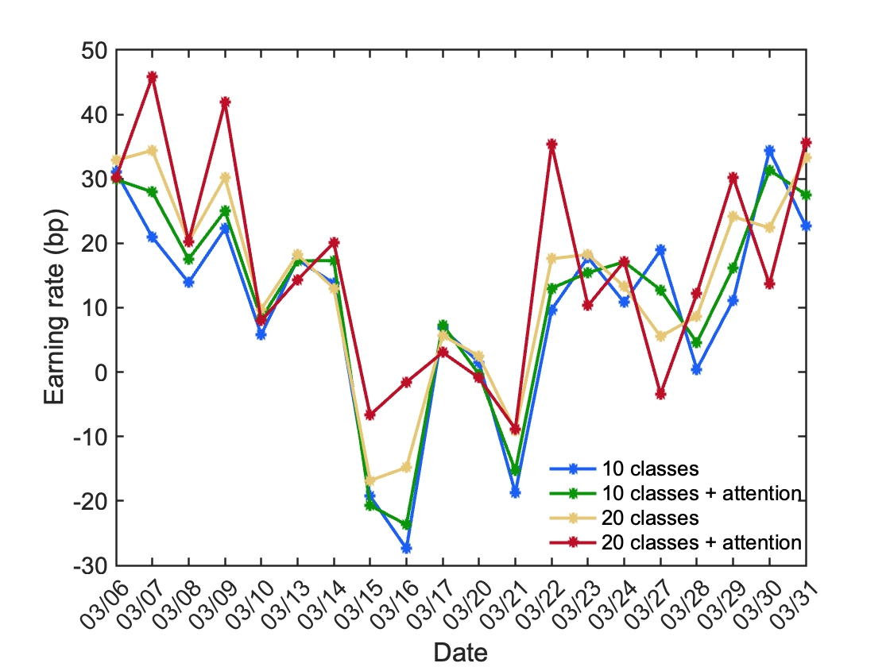
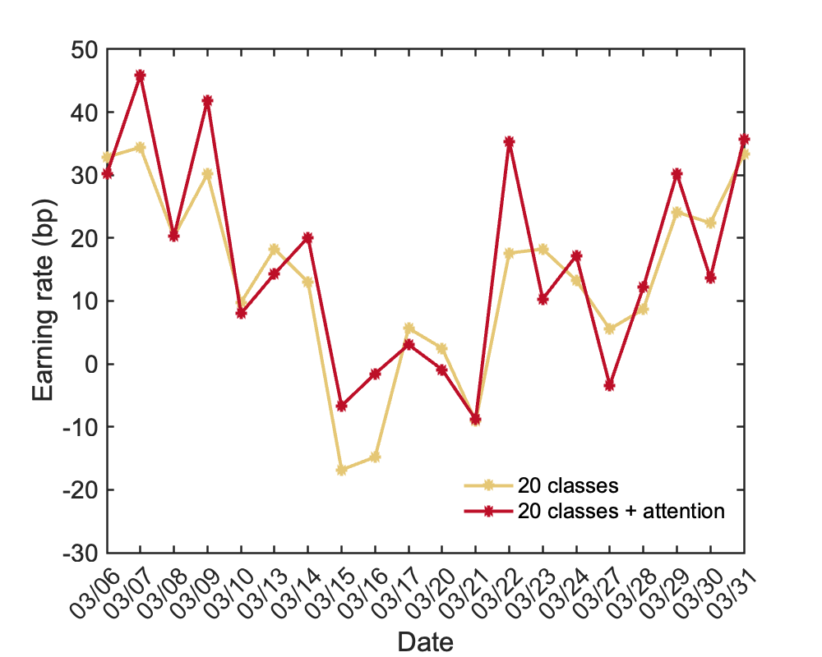
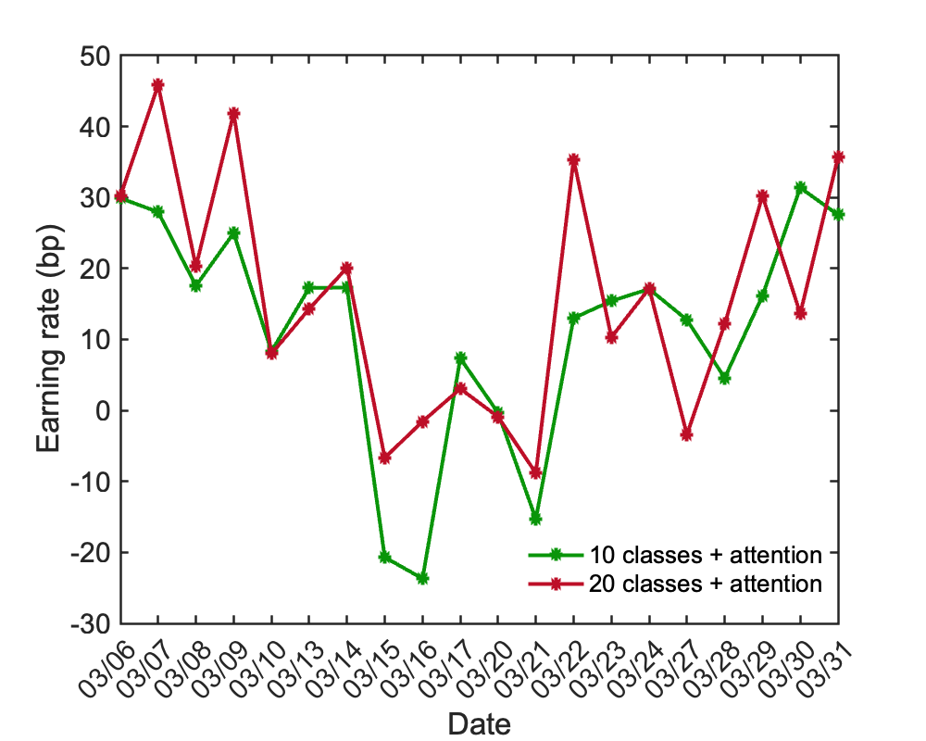
3. Result and Evaluation
d. Exploration of Methods and Potential Improvement
a.Original 10 vs Attention 10
b. Original 10 vs Original 20
c. Original 20 vs Attention 20
d. Attention 10 vs Attention 20

Slide 17
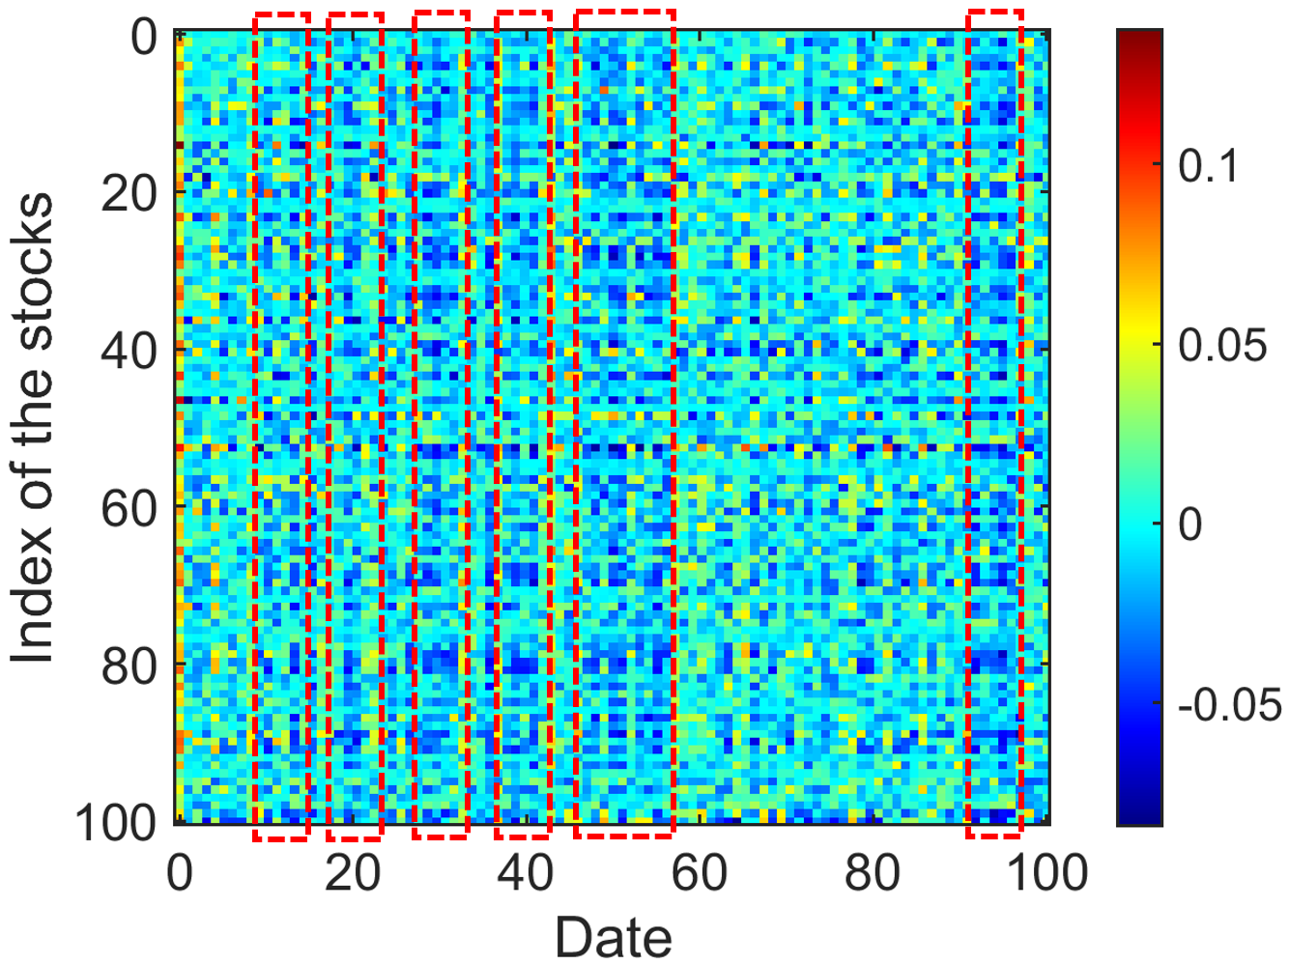
3. Result and Evaluation
d. Exploration of Methods and Potential Improvement
1
Unsupervised Learning
Extract features and learn the data correlation between days. Have a dynamic adjustment and trading procedure. Reinforcement learning can be potentially implemented in the program.
Correlation Strength
2
More Updated Attention Layer
Current attention layer used is 2018 version. More advanced version may bring better outcome.
3
More Data
If more data points are fed into the model, it can perform better.
Notes:
unsupervised learning
attention layer used is 2018 version→ can be more advanced
reinforcement learning
if have access to more data → better performance

Slide 18









4. Cloud Services and Functions
1
Elastic IP address
2
Elastic Cloud Server (ECS)
3
ModelArts
Maximum bandwidth of 300 Mb/s, highly reliable and efficient
Highly capable for small-scale model training at the early stage
Easily transfer data between different Huawei servers
Easy transfer of program files to and from the ECS
Strong computational power for large-scale training on data
Effective transfer stock data from competition server to our own ECS server.
Put model files and programs quickly and easily
Effective training and exploration
Greater efficiency and productivity
Notes:
Elastic IP: upload all 100 csv files
ECS: strong computational power → made training faster and enabled us to try different methods
ModelArts: split the work and try out different approaches simultaneously

Slide 19
Thank you!

Slide 20
Team Alchemy Squad
Kong Heyi,
Computer Science
Lyu Lanqing, Quantitative Finance
Nie Xiaoyu, Physics
Yin Li,
Industrial Systems Engineering
Zhang Zishuo, Business Analytics
Qi Fulin, Mathematics

Slide 22
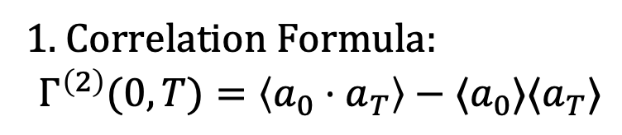
Appendix
1. Correlation Formula:
$$Γ^{\left(2\right)}(0,T)=\left\langle a_{0}⋅a_{T}\right\rangle −⟨a_{0}⟩⟨a_{T}⟩$$

Slide 23
